Slide 1
CS1231
Tutorial 5

Slide 2
Things to do
Quiz 1
Teaching Survey
Assignment
Review of lectures
Sheet 5
Further questions
Conclusion

Slide 3
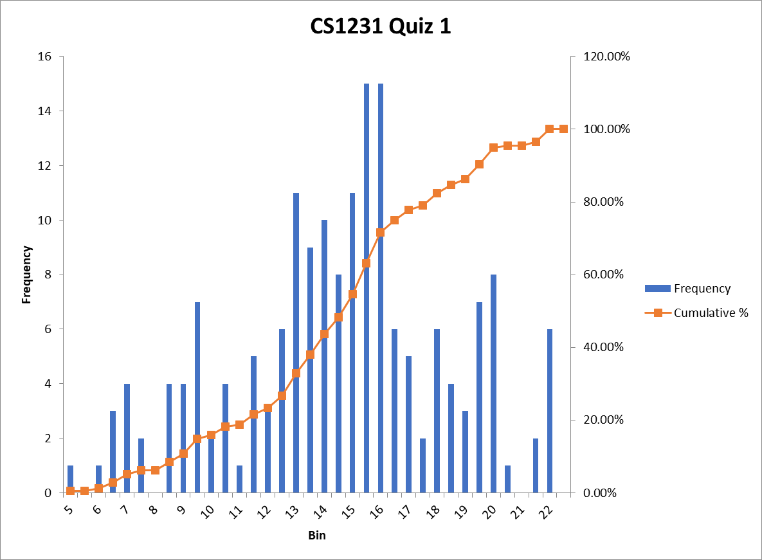
Quiz 1 (Results)

Slide 4
Quiz 1 (Results)

Slide 5
Quiz 1 (Comments)
Pay attention to detail.
Read the questions carefully.
Answer the question.
Don’t make problems more difficult then they already are.

Slide 6
Quiz 1 (Comments) Common Concerns
Answering the question in the wrong order.
Writing is illegible or ambiguous.
Answers not elaborated and only make sense after further clarification on telegram/email.

Slide 7
Survey (Results)
The tutor's explanation is clear and coherrent.
Options | Number of Responses | Percentage
Always | 15 | 34.88%
Mostly | 21 | 48.84%
Sometimes | 3 | 6.98%
Rarely | 0 | 0.%
Never | 0 | 0.%
Skip | 4 | 9.3%
The tutor's answers my questions and clarifies my doubts.
Options | Number of Responses | Percentage
Always | 22 | 51.16%
Mostly | 14 | 32.56%
Sometimes | 3 | 6.98%
Rarely | 0 | 0.%
Never | 0 | 0.%
Skip | 4 | 9.3%

Slide 8
Survey (Results)
The tutor adequately prepares me for assessments (homework and quizes).
Options | Number of Responses | Percentage
Always | 15 | 34.88%
Mostly | 18 | 41.86%
Sometimes | 6 | 13.95%
Rarely | 0 | 0.%
Never | 0 | 0.%
Skip | 4 | 9.3%
The tutorials are fun and engaging.
Options | Number of Responses | Percentage
Always | 12 | 27.91%
Mostly | 17 | 39.53%
Sometimes | 7 | 16.28%
Rarely | 1 | 2.33%
Never | 0 | 0.%
Skip | 6 | 13.95%

Slide 9
Survey (Results)
Participation during tutorial is useful for my learning experience. (Either as a participant or observer).
Options | Number of Responses | Percentage
Agree | 35 | 81.4%
Disagree | 3 | 6.98%
Skip | 5 | 11.63%
I like that the tutor takes the time to ocassionaly motivate my interest in the course material by referencing content outside of the syllabus.
Options | Number of Responses | Percentage
Agree | 34 | 79.07%
Disagree | 5 | 11.63%
Skip | 4 | 9.3%

Slide 10
Survey (Comments)
Could spend more time revising through basic concepts.
More exam/question practice.
Could step in faster to help those in doubt.
Pacing is too slow.
Could speak faster.

Slide 11
Survey (Changes)
I will spend more time reviewing lecture material. Not too much time because tutorials are not supplementary lectures.
Lectures are to provide you with content and tutorials are here to help you with your problem-solving skills.
We will be more selective with the questions from homework sheets that we will review during tutorials.
I will spend more time on those problems that I think are important and highlight key concepts and problem-solving skills that we can take away from the question.

Slide 12
Survey (Changes)
More new and challenging questions will be posed to you during the tutorials in order to give you more practice.
What I need from you is for you to participate more. Try not to use the cross reaction if possible.
I realize that some of you more reserved, but all it takes is a little bit of practice.

Slide 13
Survey (Changes)
I will speak faster, but not too fast so that students who need more time or have trouble hearing can still follow.
Tutorials are for a group with different interests and abilities. I need to teach for a general audience. If the class is too slow for you, you’re welcome to watch the recording on Fridays.

Slide 14
Assignment
3 questions. 20 marks.
No reason why you shouldn’t be walking always with all 20 marks.
Use all your resources. Read your notes, email me if you need help.
Answer each new question on a fresh sheet of paper.
Make sure that your solutions are neat and legible.

Slide 15

Review of lectures (Participation)
What does it mean to call $𝒞$ is a partition of set $A$?
What does it mean to say that $R$ is an equivalence relation on set $A$?

Slide 16
Review of lectures
Definition 6.1.1. Call C a partition of a set A if
(i) C is a set of nonempty subsets of A;
(ii) every element of A is in some element of C ;
(iii) if two elements of C have a nonempty intersection, then they are equal.
Definition 6.2.11. An equivalence relation is a relation that is reflexive, symmetric and transitive.

Slide 17
Review of lectures (Participation)
Let ∼ be an equivalence relation on a set A. Show that the equivalence classes of ∼ form a partition of A.

Slide 18
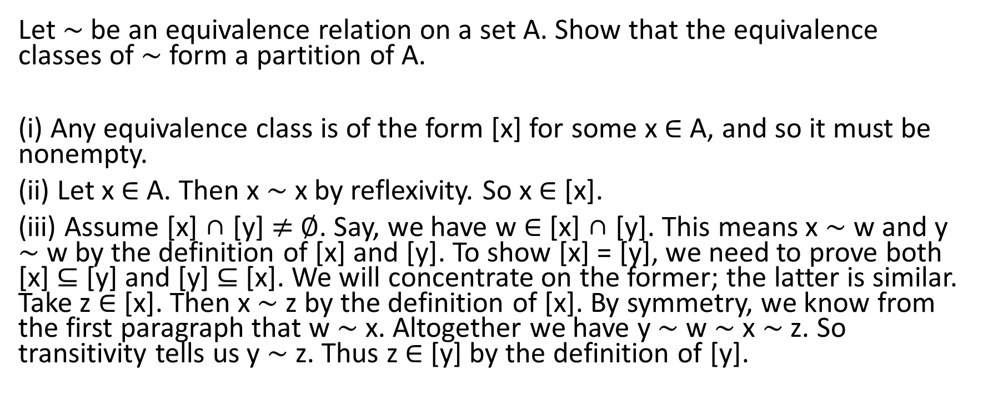
Review of lectures
Let ∼ be an equivalence relation on a set A. Show that the equivalence classes of ∼ form a partition of A.
(i) Any equivalence class is of the form [x] for some x ∈ A, and so it must be nonempty.
(ii) Let x ∈ A. Then x ∼ x by reflexivity. So x ∈ [x].
(iii) Assume [x] ∩ [y] $≠$ ∅. Say, we have w ∈ [x] ∩ [y]. This means x ∼ w and y ∼ w by the definition of [x] and [y]. To show [x] = [y], we need to prove both [x] ⊆ [y] and [y] ⊆ [x]. We will concentrate on the former; the latter is similar. Take z ∈ [x]. Then x ∼ z by the definition of [x]. By symmetry, we know from the first paragraph that w ∼ x. Altogether we have y ∼ w ∼ x ∼ z. So transitivity tells us y ∼ z. Thus z ∈ [y] by the definition of [y].

Slide 19

Review of lectures (Participation)
Let C be a partition of set A. Show that $∃$ an equivalence relation R on set A such that the set of equivalence classes of R is precisely C.

Slide 20
Review of lectures (Participation)
Define what it means for a relation R to be a partial order on set A.
When is a partial order a total order?

Slide 21
Review of lectures
Definition 6.4.1. Let A be a set and R be a relation on A.
(1) R is antisymmetric if ∀x, y ∈ A (x R y ∧ y R x ⇒ x = y).
(2) R is a (non-strict) partial order if R is reflexive, antisymmetric, and transitive.
(3) Suppose R is a partial order. Let x, y ∈ A. Then x, y are comparable (under R) if x R y or y R x.
(4) R is a (non-strict) total order or a (non-strict) linear order if R is a partial order and ∀x, y ∈ A (x R y ∨ y R x).

Slide 22
Review of lectures (Participation)
Exhibit an example of a partial order. Is it a total order?

Slide 23
Sheet 5: Question 1
Please review it on your own.

Slide 24
Sheet 5: Question 2
Starred question.

Slide 25
Sheet 5: Question 3
An exercise on identifying reflexivity, symmetricity, anti-symmetricity and transitivity.

Slide 26
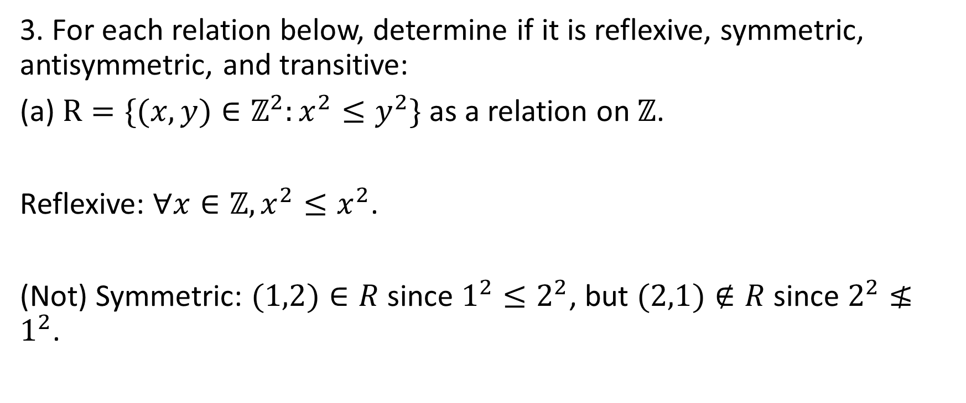
Sheet 5: Question 3
3. For each relation below, determine if it is reflexive, symmetric, antisymmetric, and transitive:
(a) $R=\{(x,y)∈ℤ^{2}:x^{2}{≤y}^{2}\}$ as a relation on $ℤ$.
Reflexive: $∀x∈ℤ,x^{2}≤x^{2}$.
(Not) Symmetric: $(1,2)∈R$ since $1^{2}≤2^{2}$, but $(2,1)∉R$ since $2^{2}≰1^{2}$.

Slide 27
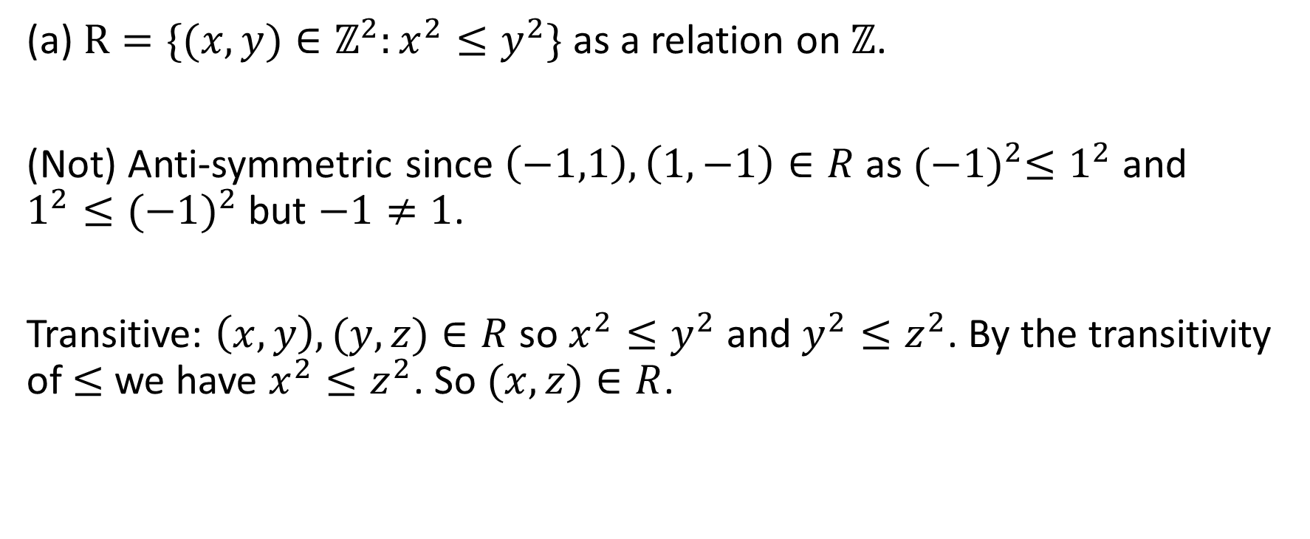
Sheet 5: Question 3
(a) $R=\{(x,y)∈ℤ^{2}:x^{2}{≤y}^{2}\}$ as a relation on $ℤ$.
(Not) Anti-symmetric since $\left(−1,1\right),\left(1,−1\right)∈R$ as ${(−1)}^{2}{≤1}^{2}$ and $1^{2}≤{(−1)}^{2}$ but $−1≠1$.
Transitive: $\left(x,y\right),(y,z)∈R$ so $x^{2}{≤y}^{2}$ and $y^{2}≤z^{2}$. By the transitivity of $≤$ we have $x^{2}≤z^{2}$. So $(x,z)∈R$.

Slide 28
Sheet 5: Question 3
(b) and ( c ) are starred.
(d) is similar to (a).

Slide 29
Sheet 5: Question 4,5&6.
Starred Questions.

Slide 30
Sheet 5: Question 7
A question on equivalence relation and equivalence classes.

Slide 31
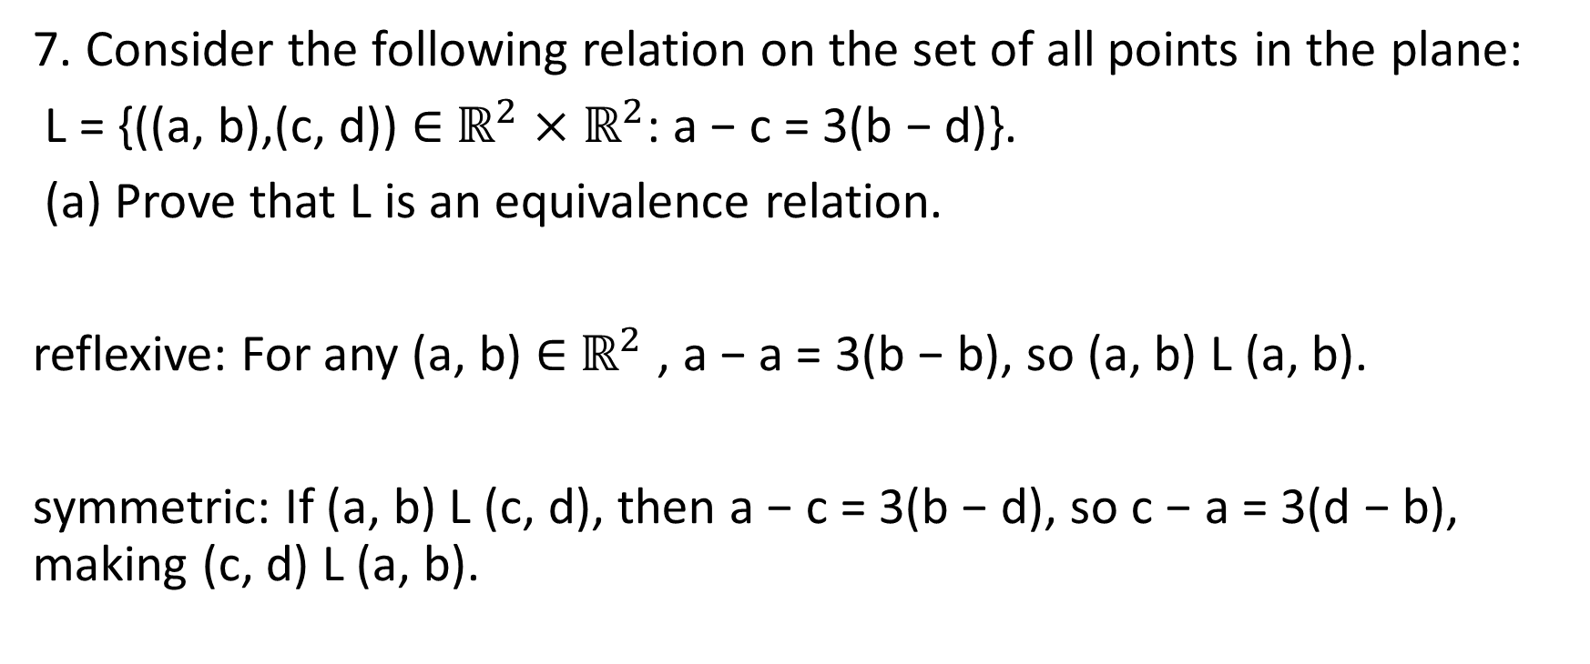
Sheet 5: Question 7
7. Consider the following relation on the set of all points in the plane:
L = {((a, b),(c, d)) ∈ $ℝ^{2}×ℝ^{2}$: a − c = 3(b − d)}.
(a) Prove that L is an equivalence relation.
reflexive: For any (a, b) ∈ $ℝ^{2}$ , a − a = 3(b − b), so (a, b) L (a, b).
symmetric: If (a, b) L (c, d), then a − c = 3(b − d), so c − a = 3(d − b), making (c, d) L (a, b).

Slide 32
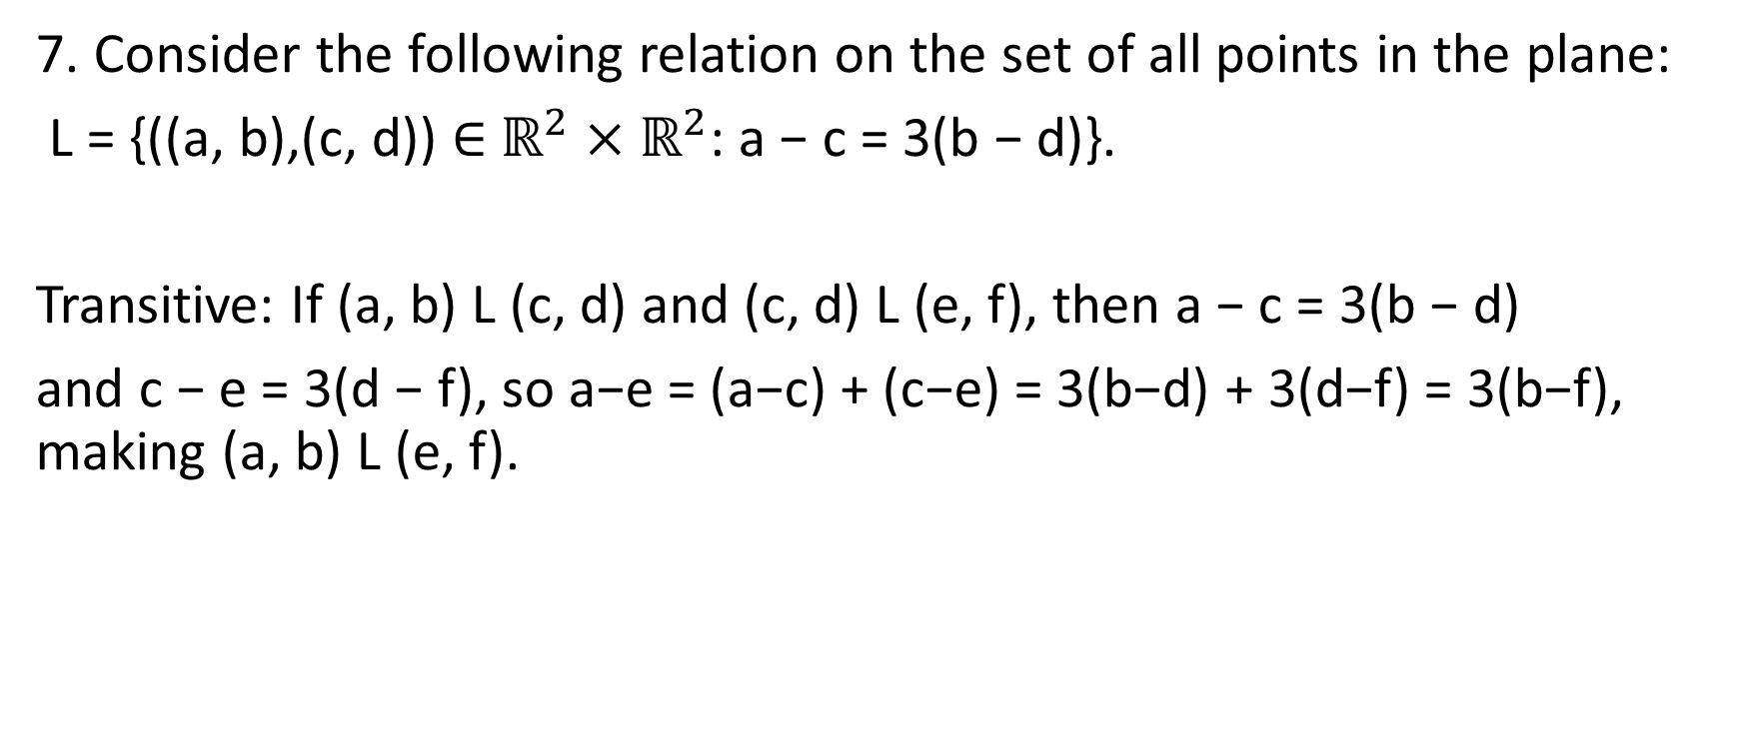
Sheet 5: Question 7
7. Consider the following relation on the set of all points in the plane:
L = {((a, b),(c, d)) ∈ $ℝ^{2}×ℝ^{2}$: a − c = 3(b − d)}.
Transitive: If (a, b) L (c, d) and (c, d) L (e, f), then a − c = 3(b − d)
and c − e = 3(d − f), so a−e = (a−c) + (c−e) = 3(b−d) + 3(d−f) = 3(b−f), making (a, b) L (e, f).

Slide 33
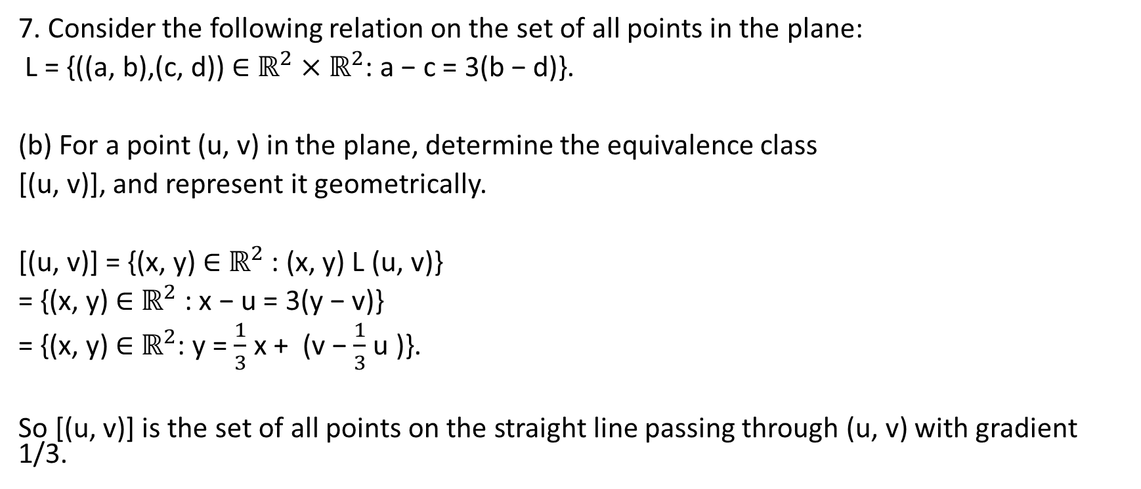
Sheet 5: Question 7
7. Consider the following relation on the set of all points in the plane:
L = {((a, b),(c, d)) ∈ $ℝ^{2}×ℝ^{2}$: a − c = 3(b − d)}.
(b) For a point (u, v) in the plane, determine the equivalence class
[(u, v)], and represent it geometrically.
[(u, v)] = {(x, y) ∈ $ℝ^{2}$ : (x, y) L (u, v)}
= {(x, y) ∈ $ℝ^{2}$ : x − u = 3(y − v)}
= {(x, y) ∈ $ℝ^{2}$: y = $\frac{1}{3}$ x + (v − $\frac{1}{3}$ u )}.
So [(u, v)] is the set of all points on the straight line passing through (u, v) with gradient 1/3.

Slide 34
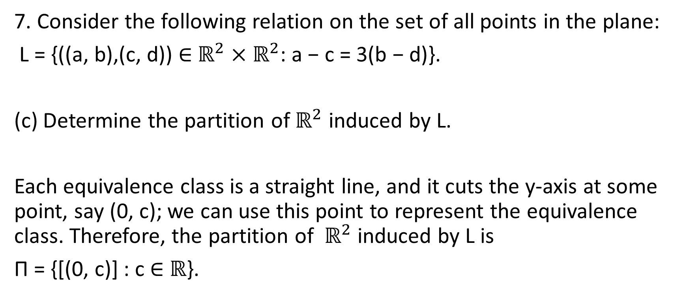
Sheet 5: Question 7
7. Consider the following relation on the set of all points in the plane:
L = {((a, b),(c, d)) ∈ $ℝ^{2}×ℝ^{2}$: a − c = 3(b − d)}.
(c) Determine the partition of $ℝ^{2}$ induced by L.
Each equivalence class is a straight line, and it cuts the y-axis at some point, say (0, c); we can use this point to represent the equivalence class. Therefore, the partition of $ℝ^{2}$ induced by L is
Π = {[(0, c)] : c ∈ $ℝ$}.

Slide 35
Sheet 5: Question 8
Equivalence of definitions of equivalence classes.

Slide 36
Sheet 5: Question 8
8. Let R be an equivalence relation on set X. Prove that, for any b, c ∈ X, b R c if and only if [b] = [c].
(⇒) Assume b R c. Then c ∈ [b]. Consider any y ∈ [c]. Then c R y. Since b R c, we deduce that b R y by transitivity. So y ∈ [b]. Thus [c] ⊆ [b]. Also, [b]⊆ [c] by a similar argument. All these show [b] = [c].
(⇐) Assume [b]= [c]. Reflexivity implies c ∈ [c] and so c ∈ [b]. This means b R c.

Slide 37
Sheet 5: Question 9
A good exercise on constructing counter-examples.

Slide 38
Sheet 5: Question 9
9. Prove or disprove:
A relation that is symmetric cannot be antisymmetric.
A symmetric relation cannot be antisymmetric: false Example: the relation {(a, a)} on {a} is both symmetric and antisymmetric

Slide 39
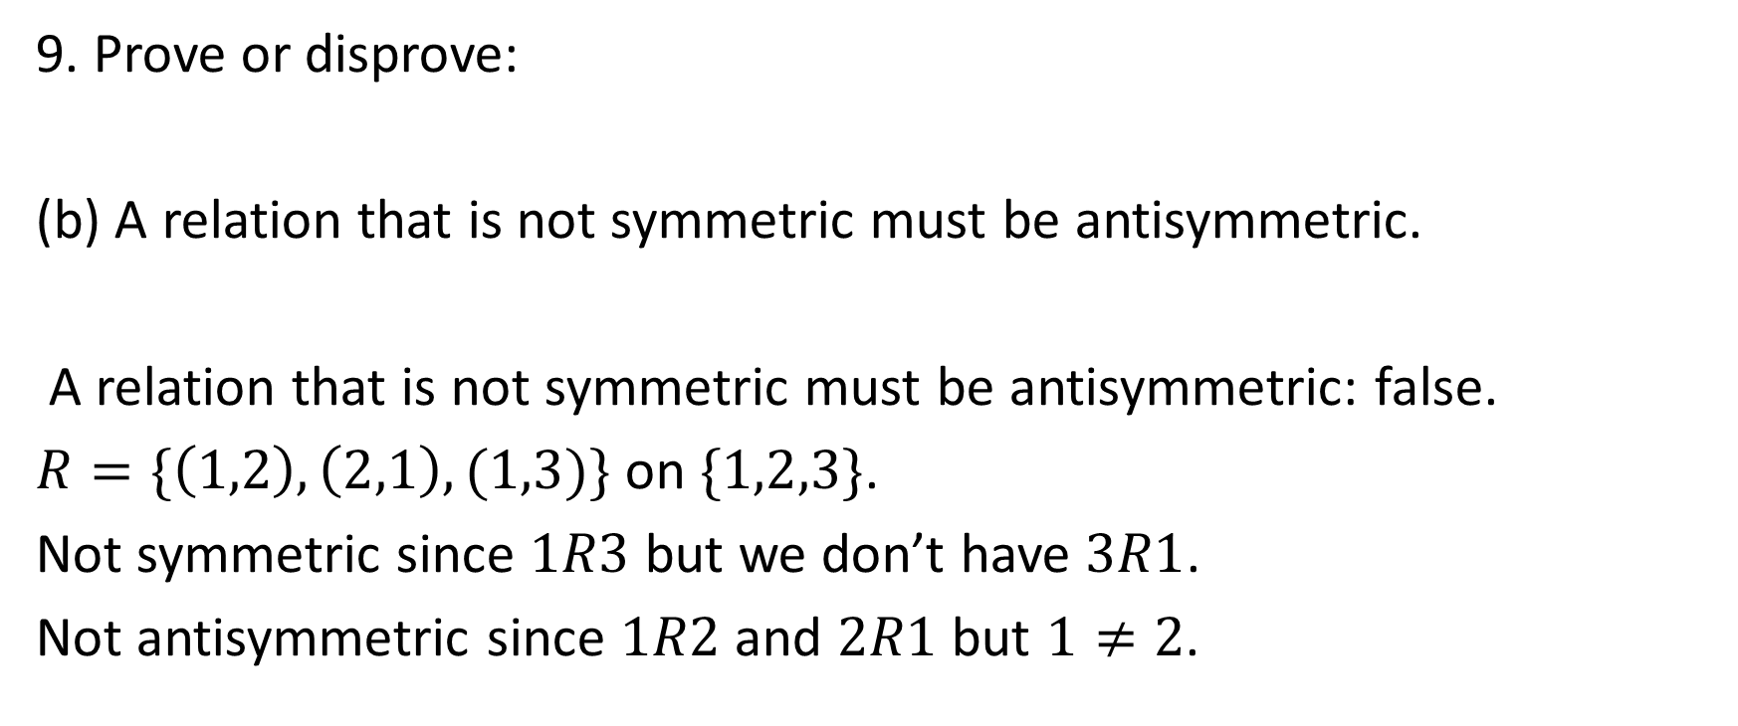
Sheet 5: Question 9
9. Prove or disprove:
(b) A relation that is not symmetric must be antisymmetric.
A relation that is not symmetric must be antisymmetric: false.
$R=\{\left(1,2\right),\left(2,1\right),(1,3)\}$ on $\{1,2,3\}$.
Not symmetric since $1R3$ but we don’t have $3R1$.
Not antisymmetric since $1R2$ and $2R1$ but $1≠2$.

Slide 40
Sheet 5: Question 10
Please review it on your own.

Slide 41
Sheet 5: Questions 11,12,13
Starred Questions.

Slide 42
Sheet 5: Question 14
An inductive proof.

Slide 43

Sheet 5: Question 14
14. Continued from Tutorial 4 Problem 13. Prove that, when C = $2^{n}$ where n ∈ $ℤ^{+}$, there is always a solution,
i.e., no matter which unit square is singled out on a $2^{n}×2^{n}$ chessboard, the rest can be covered by non-overlapping L-tiles.

Slide 44
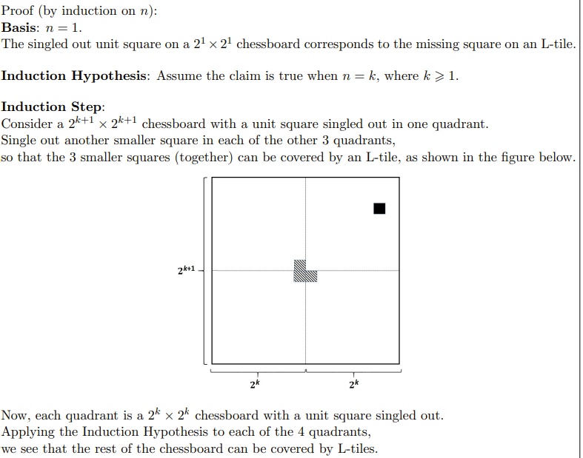
Sheet 5: Question 14

Slide 45
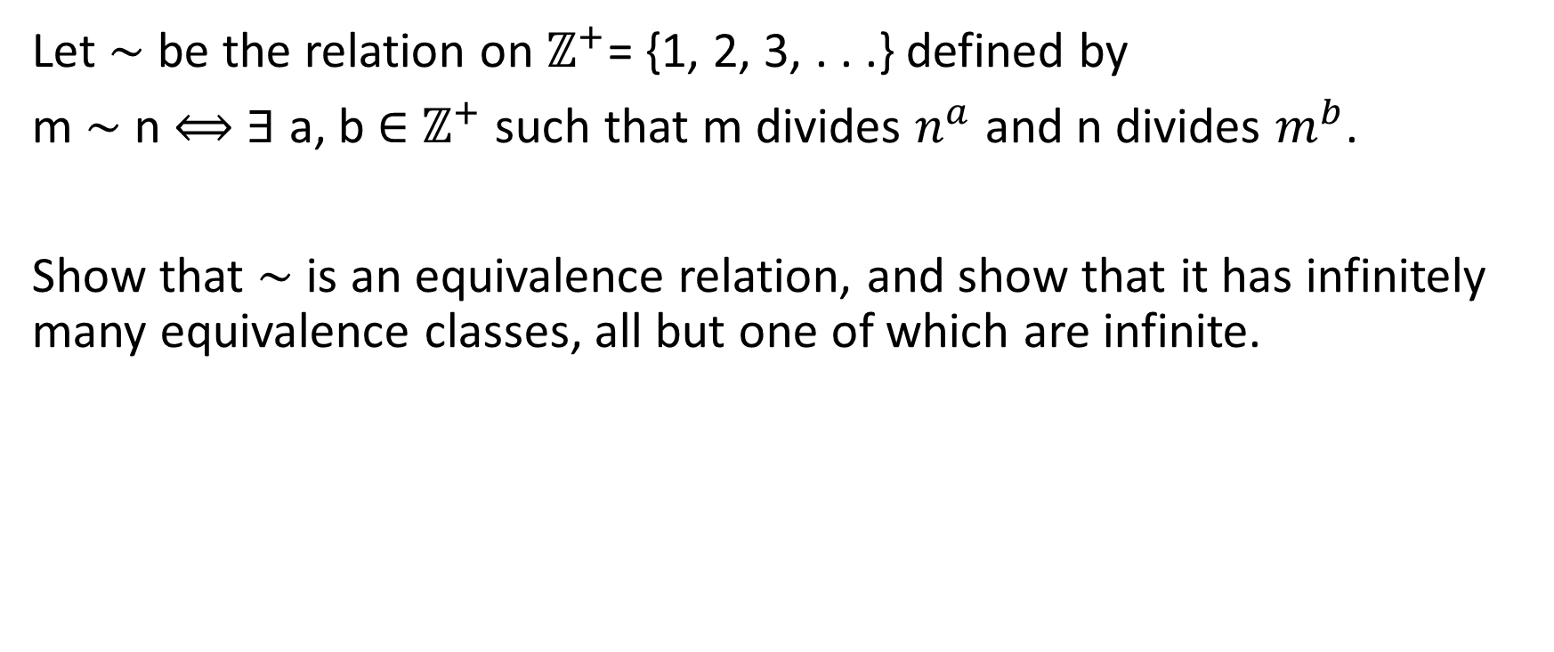
Further Questions
Let ∼ be the relation on $ℤ^{+}$= {1, 2, 3, . . .} defined by
m ∼ n $⟺$ ∃ a, b ∈ $ℤ^{+}$ such that m divides $n^{a}$ and n divides $m^{b}$.
Show that ∼ is an equivalence relation, and show that it has infinitely many equivalence classes, all but one of which are infinite.

Slide 46

Further Questions
Let ∼ be the relation on $ℤ^{+}$= {1, 2, 3, . . .} defined by
m ∼ n $⟺$ ∃ a, b ∈ $ℤ^{+}$ such that m divides $n^{a}$ and n divides $m^{b}$.
Reflexivity:
Symmetricity:

Slide 47

Further Questions
Let ∼ be the relation on $ℤ^{+}$= {1, 2, 3, . . .} defined by
m ∼ n $⟺$ ∃ a, b ∈ $ℤ^{+}$ such that m divides $n^{a}$ and n divides $m^{b}$.
Transitivity:

Slide 48

Further Questions
Let ∼ be the relation on $ℤ^{+}$= {1, 2, 3, . . .} defined by
m ∼ n $⟺$ ∃ a, b ∈ $ℤ^{+}$ such that m divides $n^{a}$ and n divides $m^{b}$.
Equivalence Relations:

Slide 49
Further Questions
If R and S are two equivalence relations on the same set A,
Show that the following conditions are equivalent:
(i) R ◦ S is a symmetric relation on A ;
(ii) R ◦ S is a transitive relation on A ;
(iii) S ◦ R ⊆ R ◦ S ;
(iv) R ◦ S is the unique smallest equivalence relation on A containing both R and S.

Slide 50

Further Questions
(i) R ◦ S is a symmetric relation on A $⟺$
(ii) R ◦ S is a transitive relation on A ;

Slide 51

Further Questions
(i) R ◦ S is a symmetric relation on A $⟺$
(iii) S ◦ R ⊆ R ◦ S ;

Slide 52

Further Questions
(i) R ◦ S is a symmetric relation on A $⟺$
(iv) R ◦ S is the unique smallest equivalence relation on A containing both R and S.

Slide 53
Conclusion

